Slide 1

Project Title: E-Commerce Website Development
Presented by: Ome Prakash Domain: Web Development (Frontend + Backend)

Slide 2
Project Objective :
The objective of this project is to build a fully functional and user-friendly E-Commerce website with both frontend and backend capabilities.
The goal is to allow users to:
Signup and login securely
View products
Manage their account
And later, add items to cart and place orders

Slide 3
Work Completed So Far :
🔹 Designed responsive UI using HTML and CSS 🔹 Developed Signup, Login, and Account pages 🔹 Successfully implemented localStorage for user data 🔹 Dynamically showed/hid navigation buttons based on login state 🔹 Connected navigation flow between pages

Slide 4
Technologies Used :
Frontend:
HTML5
CSS3 (Animations, Transitions)
JavaScript (DOM, LocalStorage)
Tools:
VS Code
Live Server
Browser DevTools
Backend (Upcoming):
Spring Boot (Java)
MySQL Database
REST APIs

Slide 5
Implemented Pages :
Each page is modular, with a dedicated CSS file. For example, signup.css focuses on form layout and styling, while login.css handles animations and validation styles. I’ve also included smooth animations and hover effects to improve the user experience.

Slide 6
User Flow :
User clicks Signup
Fills the form and clicks Continue
Gets redirected to the Login page
After successful login, gets redirected to shopping (home) page
Account and Logout buttons become visible
Clicking Account opens account.html with user details
Back to Home redirects to shopping page
Clicking Logout clears session and shows login/signup buttons again

Slide 7
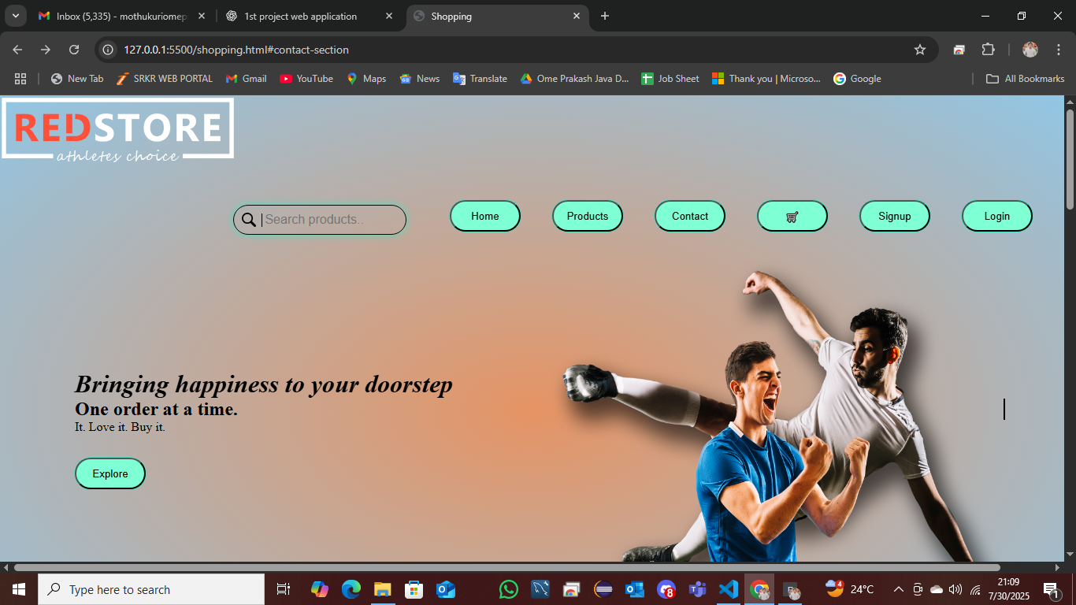
Current Output :

Slide 8
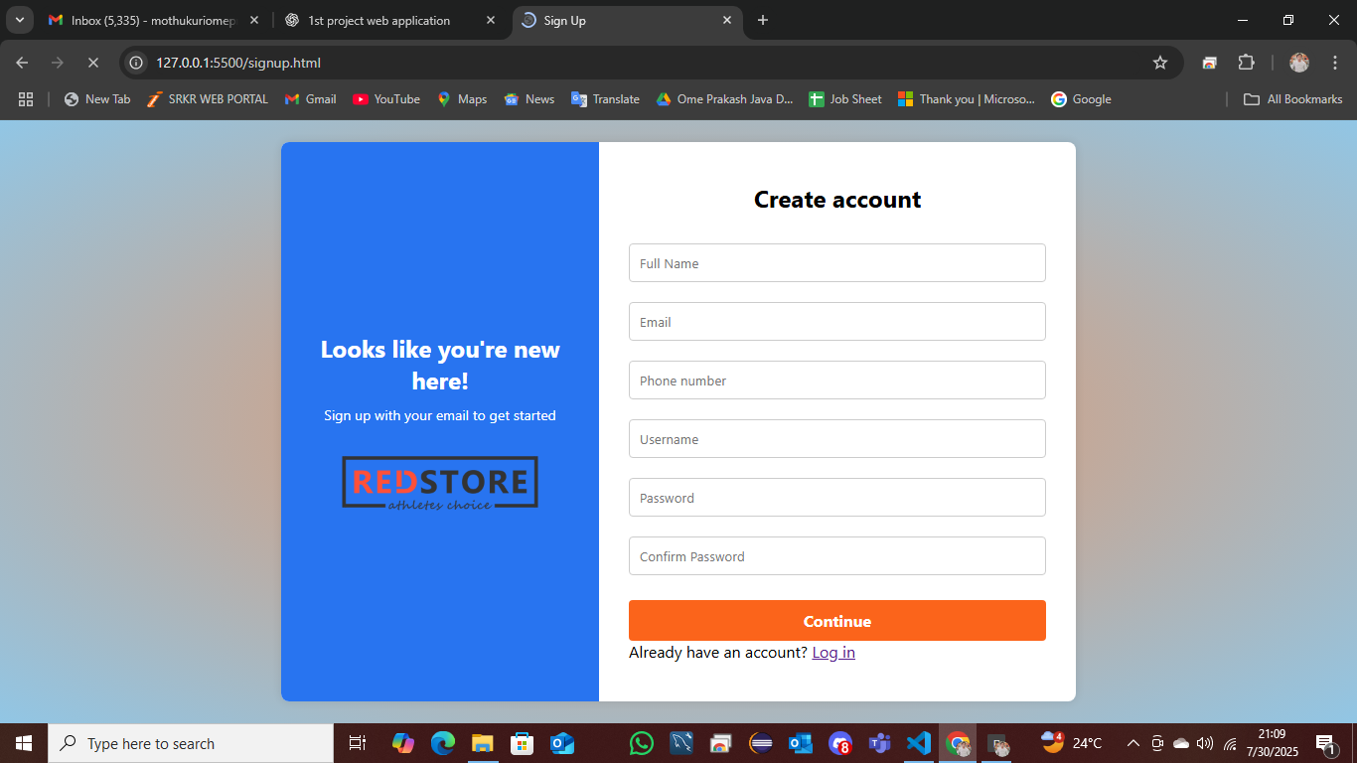
Current Output :

Slide 9
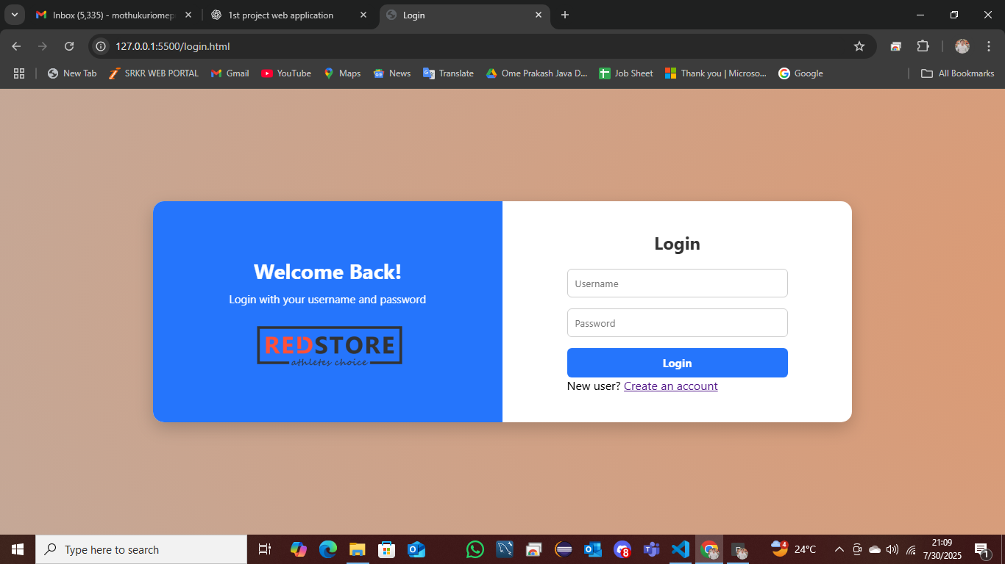
Current Output :

Slide 10
Next Plan – Backend Integration :
Build backend using Spring Boot ✅ Use MySQL to store real user and product data ✅ Add features:
Add to cart
Place orders
Admin login to manage inventory ✅ Secure login using sessions or JWT

Slide 11
Conclusion :
So far, I have completed the entire frontend with authentication system using HTML, CSS, and JavaScript. The next step is to begin the backend development and connect it with frontend via REST APIs.

Slide 12
Thank You
Thank you for your time! I look forward to completing the full-stack development of this E-Commerce platform.
Presented by: Ome Prakash Domain: Java Full Stack Developer

